Slide 1
Principals of Management of Poisoning
Dr.Shaluka Jayamanne

Slide 2
Summary of Lecture
General Principles in the Management of any Poisoning
Specific management options with certain substances
  Pesticides
  Plant Poisoning
  Drugs - Paracetamol

Slide 3
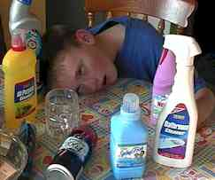
Accidental?

Slide 4
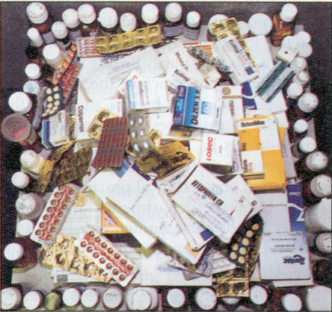
Deliberate?

Slide 5
The Case….
Picture yourself in Polonnaruwa hospital – Intern
Ward 6 , teaming with patients….
nurse tells you there is a sick patient
  36yo F
  Taken 100mls of Dimethoate after a domestic argument
There’s nowhere to run, or hide…. So you see the patient – what do you do?

Slide 6
Important Steps in the Management
Resuscitation
Gastric Decontamination
Specific Management- antidotes
Monitoring
Management of Complications
Psychiatric assessment

Slide 7
General Management -History
Applies to ANY episode of Poisoning
WHAT
HOW MUCH (Ideally mg/Kg)
WHEN
WHAT ELSE (Including Alcohol)
WHY
Use Health care staff, friends, relatives, anyone!!

Slide 8
General Management -Resusitation
A (Airway)
B (Breathing)
C (Circulation)
D (Disability-AVPU/ Glasgow Coma Scale)
DEFG ( Don’t ever forget the Glucose)
GET A SET OF BASIC OBSERVATIONS

Slide 9
General Management –Identify the Poison Clinical Signs
Use all your senses, search for the clues
LOOK
  Track Marks
  Pupil Size
FEEL
  Temperature, Sweating
SMELL
  Alcohol

Slide 10
Specific Management Options-Decontamination
DECREASING DRUG ABSORPTION
  Gastric Lavage
  Absorbents Activated Charcoal

Slide 11
↓ Absorption
Avoid forced emesis
Gastric lavage
  Only if within 1 hour & life-threatening amount
  Never for corrosives
  If ↓ LOC intubate
Activated charcoal
  50 g single or repeated dose (↑ elimination)- effective in first 2 hours may be useful even later in certain poisons Kaneru
  Doesn’t bind heavy metals, ethanol, acids

Slide 12
Specific Management Options – Poison elimination
INCREASING DRUG ELIMINATION
  Alkaline Diuresis (Aspirin)
  Haemodialysis (Aspirin)

Slide 13
Specific Management Options - Antidotes
ANTAGONISING THE EFFECTS OF THE POISON
  Desferrioxamine (IRON)
  Naloxone (OPIATES)
  N Acetylcysteine (PARACETAMOL)
  Pralidoxime- OP

Slide 14
Investigations
Always check blood glucose.
Send blood & urine for toxicology screening.
measure paracetamol & salicylate levels.
U&Es, LFTs, glucose, ABG, clotting, bicarbonate
ECG, CXR
Specific blood levels

Slide 15
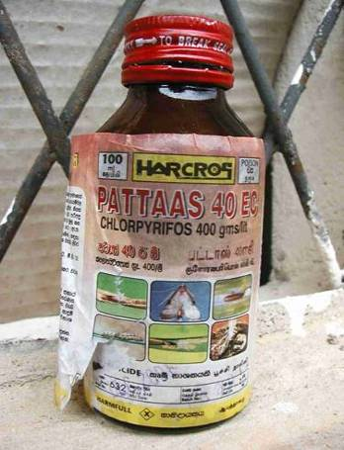
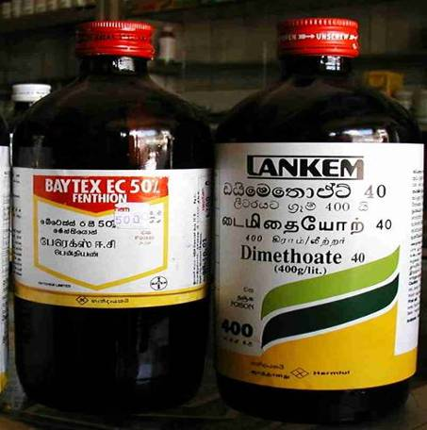
Organophosphate Pesticide Poisoning

Slide 16
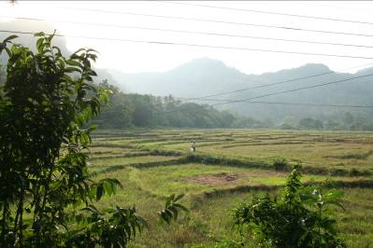
Organophosphate Poisoning in Sri Lanka
Case Fatality rates (CFR)
  10-20% for most
  50-70% for some OP’s
In west CFR
  0.3% from all poisons
Multifactorial
  Toxicity of OP’s
  Patient transport
  Lack of resources
  Training

Slide 17
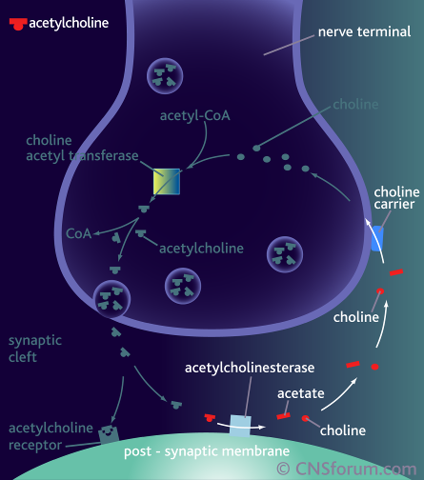
Mechanism of OP’s

Slide 18

Simplified Acute OP Toxicity
Inactivation of acetylcholinesterase enzyme
Organophosphate

Slide 19
Clinical Syndrome
}
Clinical Syndrome
Acute Cholinergic:
  Central
  Peripheral Muscarinic
  Peripheral Nicotinic
Intermediate Syndrome
OPIDN: Delayed peripheral neuropathy
Neurocognitive dysfunction
Respiratory failure
+ Death

Slide 20
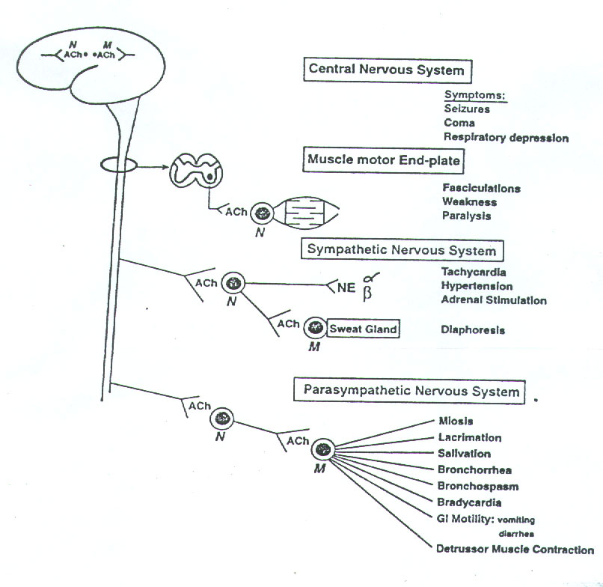

Slide 21
Cholinergic Effects
D iarrhoea
U rination
M iosis
B radycardia, Bronchorrhoea, Bronchospasm
E mesis
L acrimation
S alivation

Slide 22
CNS effects
Malaise
Memory loss
Confusion
Disorientation
Delirium
Seizures
Respiratory centre depression or dysfunction
Coma

Slide 23
Intermediate Syndrome
Delayed Respiratory Failure
  Proximal muscle weakness and cranial nerve lesions
  Typically 1-4 days after cholinergic crisis has resolved
Prolonged Effects on Nicotinic receptors
Primary motor end plate degeneration
Clinical importance
  Delayed respiratory failure leads to death if not aware of it or prepared for it

Slide 24
Chronic Effects
Organophosphate induced delayed neuropathy (OPIDN)
    1-3weeks
    Peripheral neuropathy
    Axonopathy due to Neuropathy Target Esterases (NTE)
Chronic organophosphate induced neuropsychiatric disorder (COPIND)

Slide 25

Management
The priorities in management are to:
Resuscitation
Atropinisation of symptomatic patients
Decontamination
Other Treatments - Pralidoxim

Slide 26
Antidotes
  ? Dose
  ? Duration
  ? Effectiveness
Atropine
Pralidoxim
  Expensive

Slide 27
Does the patient need atropine?
How much and for how long

Slide 28
Atropine
Loading
  Doubling dose regime e.g. 2 4 8 16 mgs every 5 minutes
Maintenance
  Continuous infusion < 3mg/hr
  10-20% of loading dose/hour
Endpoints
  Clear chest on auscultation with no wheeze
  Heart rate >80 beats/min
Withdrawal
  Atropine toxicity
  Clinical Improvement

Slide 29

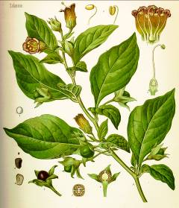
What if you give too much Atropine ?
Anticholinergic Syndrome:
  Hot as hell
  Blind as a bat
  Red as a beet
  Dry as a bone
  Mad as a hatter
Notes:
The classic anticholinergic syndrome is described as below:-
Hot as hell
Blind as a bat
Red as a beet
Dry as a bone
Mad as a hatter
Patients may have:-
Elevated BP, red dry skin, dilated pupils, bowel sounds, urinary retention, delirium and convulsion
It can occur with any anticholinergic drugs e.g. cogentin, anticholinergic plants e.g. datura, as well as antihistamines, antidepressant drugs and antipsychotic drugs.

Slide 30
Pralidoxim
Ineffective in some situations
  Ageing
  Variation between organophosphates
Protocol
  1g 6 hourly

Slide 31
Summary
OP’s are Indirect Cholinomimetic
  Block AChE, prolonged duration of ACh in synapse
Effects
  Muscarinic, Nicotinic, CNS
  Respiratory failure and Death result from this
Treatment
  ABC’s, Atropine, Decontaminate, Oximes
Important also in West

Slide 32
Other Pesticides
Carbamates
Management and clinical presentation is same as OP
PAM is not effective
Same regimen of Atropin

Slide 33
Paraquat
Paraquat Formula
Diquat
2,4dichlorophenoxyacetic acid
Color : Blue-green
emetic agent

Slide 34
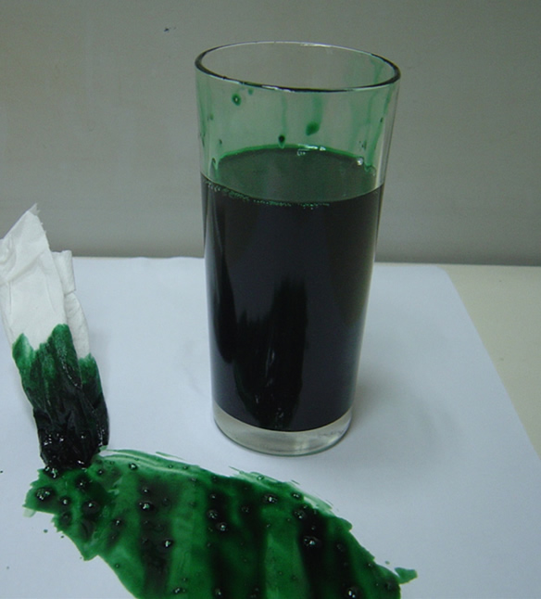
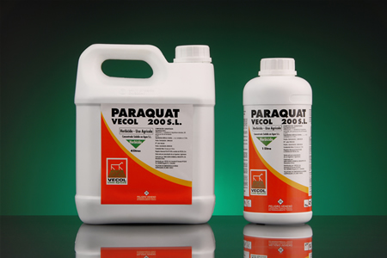
Paraquat
A leading cause of suicide

Slide 35
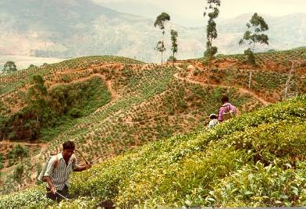

Paraquat in Sri Lankan agriculture
Non-systemic, fast acting
Rain-fast, quickly deactivated in soil
No tillage preserves soil structure
No damage to surrounding crops
Broad spectrum, no weed resistance
Key crops in Sri Lanka are tea and rice

Slide 36
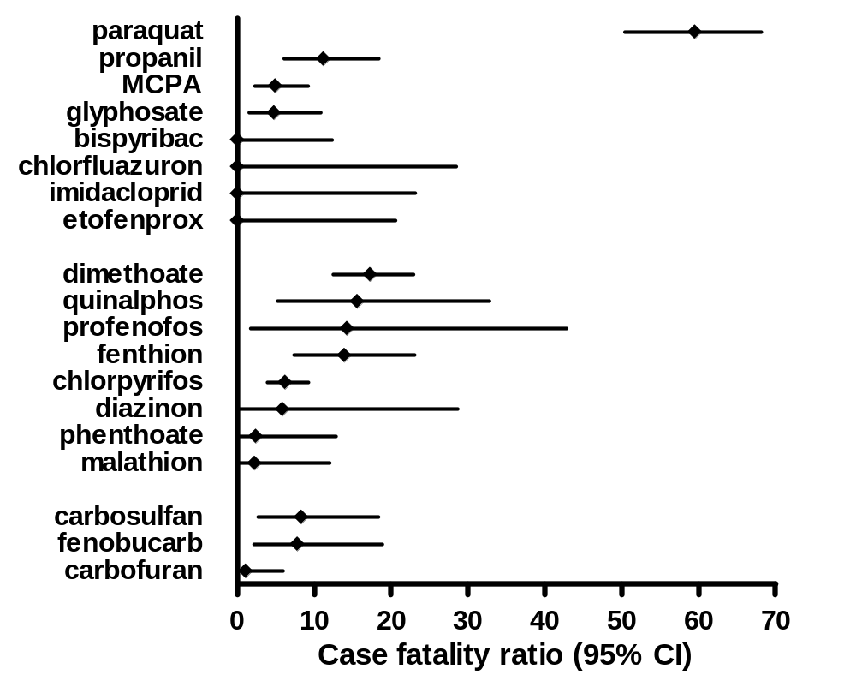
Predictors of Death
Case Fatality Rates of pesticides in self-poisoning

Slide 37
.
GSH
GSSG
.
O₂
O₂
OH
Paraquat
Lung
Lipid
peroxidation
Type I and II pneumocyte cell death & alveolitis
Lung fibrosis

Slide 38
Paraquat
Cause oxidative damage– Oxygen free radicals
Early--- Hypotension and multi organ failure– Death
Late-- up to 2-4-weeks – Pulmonary fibrosis Liver failure
Only effective treatment – Gastric decontamination – Activated charcoal / Fullers earth

Slide 39
Other Pestisides
Propanil- 3-4 DPA
Causes Methaemoglobinaemia
Antidote- Methelin Blue IV Oral
Exchange Transfusions

Slide 40
GLYPHOSATE
Glyphosate is a non-selective herbicide : of 41% Glyphosate
15% Surfactant
Glyphosate is an organophosphate but it does not act as an acetylcholinesterase inhibitor in man.
The surfactant is approximately three times as toxic as glyphosate

Slide 41
Mild | Predominantly gastrointestinal symptoms
Moderate | Gastrointestinal symptoms lasting longer than 24 hours Hypotension Pulmonary dysfunction. oliguria
Severe | Pulmonary dysfunction requiring intubation Renal failure requiring dialysis Hypotension requiring pressor amines Cardiac arrest Coma Repeated seizures Death

Slide 42
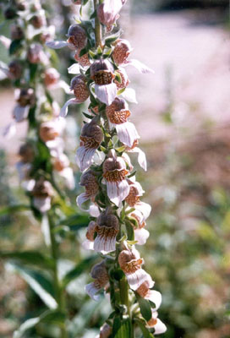
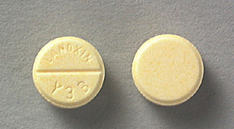
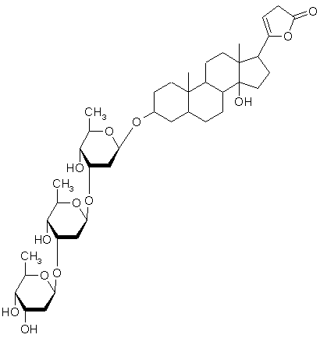
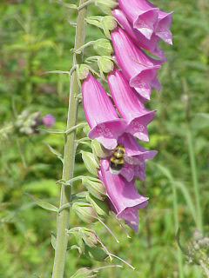
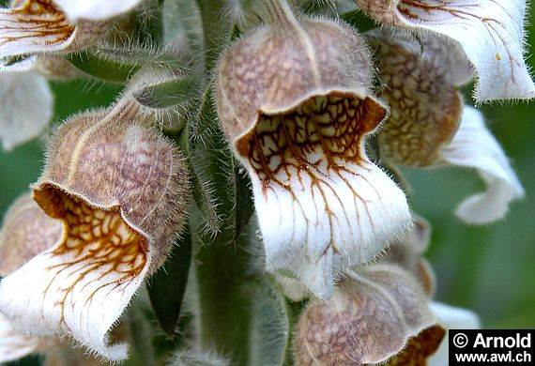
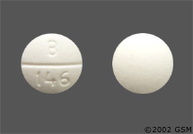

Slide 43
Plant Poisons
Kaneru
Niyangala
Enderu
Divi Kaduru
Diya Kaduru
Goda Kaduru
Olinda
Habarala
Attana

Slide 44
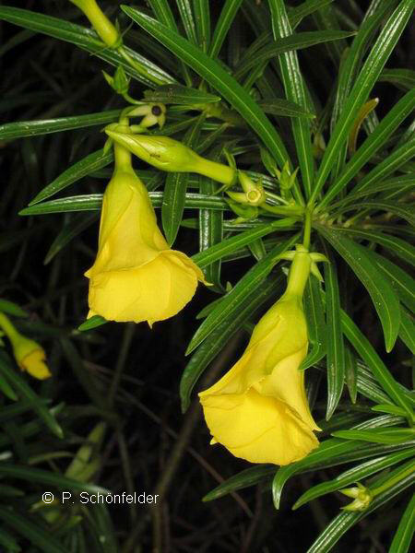
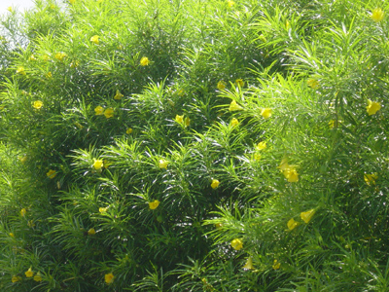
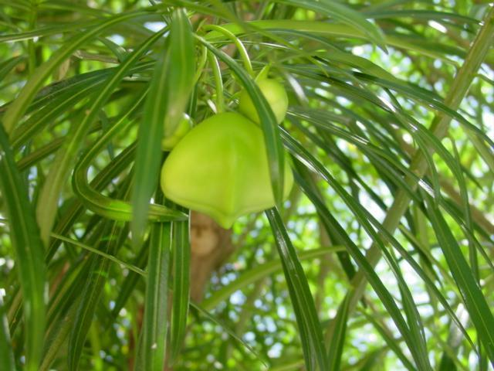

Slide 45
Symptoms of substantial
oleander poisoning
Cardiac dysrhythmias
Nausea
Vomiting
Weakness
Fatigue
Diarrhoea
Dizziness
Abdominal Pain
Visual Symptoms

Slide 46
Mode of Action
inhibit sodium-potassium ATPase
    increased intracellular sodium and serum potassium
    negative chronotropic, positive inotropic effects

Slide 47
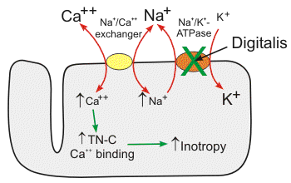
Effect of cardiac glycosides

Slide 48
Consequences of cardiac glycoside binding 1
Rises in intracellular Ca²⁺ and Na⁺ concentrations
Partial membrane depolarisation and increased automatacity
Generation u waves that may trigger dysrhythmias

Slide 49
Consequences of cardiac glycoside binding 2
Decrease in conduction through the SA and AV nodes
Due to increase in vagal parasympathetic tone and by direct depression of this tissue

Slide 50
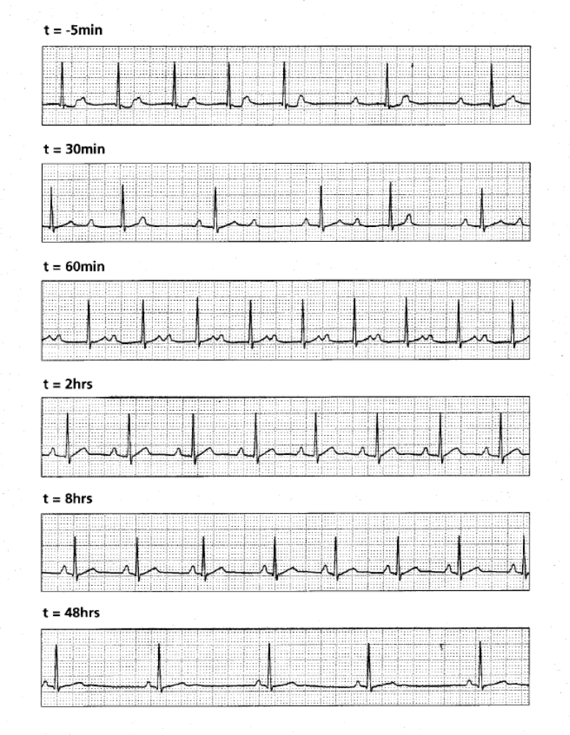

Slide 51
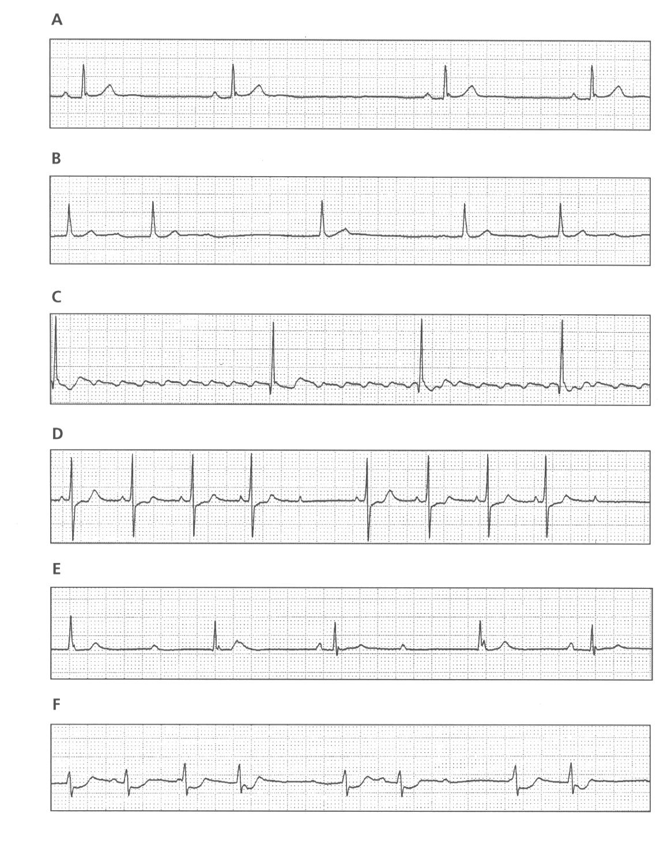
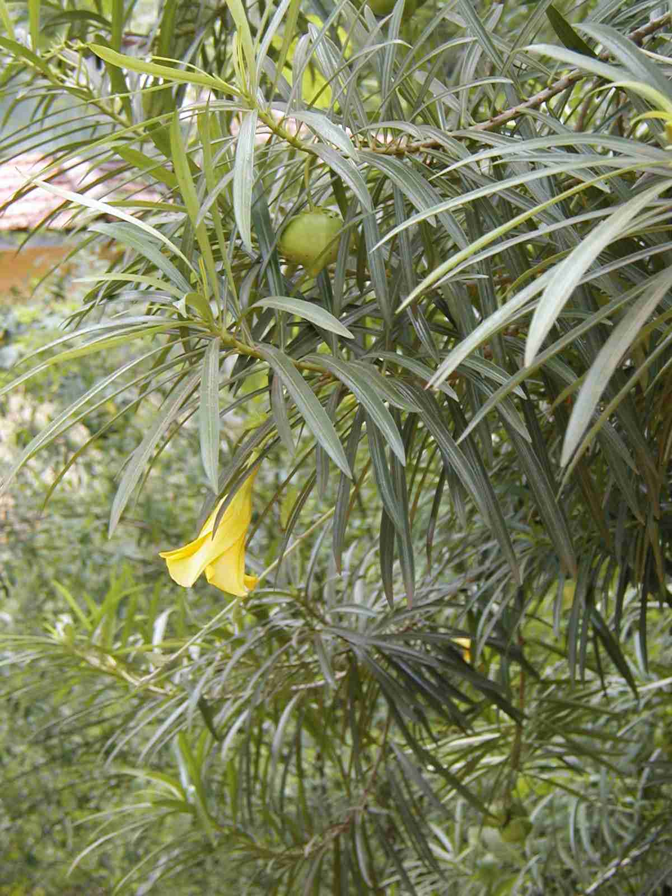
Yellow oleander cardiotoxicity

Slide 52
Standard treatment
Only two interventions have been carefully studied
Anti-digoxin/digitoxin Fab
Activated charcoal
Both these treatments work by affecting the pharmacokinetics of the cardiac glycoside, by:
speeding elimination and/or
reducing absorption

Slide 53
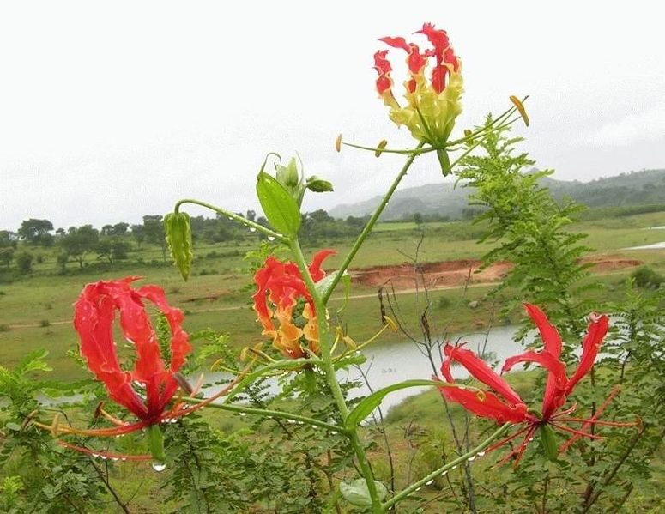
Glorisa superba
NIYAGALA

Slide 54

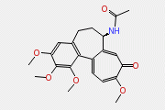
Main toxic constituents:
colchicine
Mode of action:
    Colchicine has an antimitotic effect

Slide 55
Niyagala
Clinical features of poisoning:
    Initial symptoms
    develop within 6-12 hours of ingestion
      burning pain, numbness, itching and tingling around the mouth and throat with thirst
      nausea, intense vomiting
      abdominal pain, severe diarrhea with blood and mucus
    These lead to
      electrolyte imbalance, dehydration, hypovolaemic shock manifested hypotension and tachycardia

Slide 56

    After 24 hours patients develop
      Muscle weakness, myoglobinuria, bronchial constriction, leucopenia, thrombocytopenia, clotting defects with bleeding, polyneuropathy cardiac arrhythmias, hepatic insufficiency, acute renal failure
    In severe cases there may be
      Respiratory depression, confusion, delirium, convulsions,
  Death occurs due to shock or respiratory failure

Slide 57
Management
􀂃 Aggressive early gastrointestinal decontamination - Charcoal
􀂃 Intensive supportive care
Fluid and electrolyte replacement
Ventilatory and vasopressor support
Blood and coagulation products
Antibiotic treatment
􀂃 G-CSF
􀂃 Immunotherapy with anti-colchicine antibodies

Slide 58
Paracetamol
Commonest drug poisoning
DANGEROUS AND PEOPLE DON’T KNOW IT. YOU FEEL WELL AND THEN THE LIVER FAILURE SETS IN..

Slide 59
Paracetamol-Normal Metabolism
Paracetamol converted to:
N-Acetyl-p-benzoquinonamine (TOXIC)
This is conjugated with Glutathione
Glutathione stored in the body
Produces a NON TOXIC metabolite

Slide 60
Paracetamol Metabolism in Overdose
Glutathione stores are used up by the excess Paracetamol
Toxic Metabolite build up
Binds IRREVERSIBLY to Hepatic Cell membranes
Resulting in LIVER NECROSIS

Slide 61
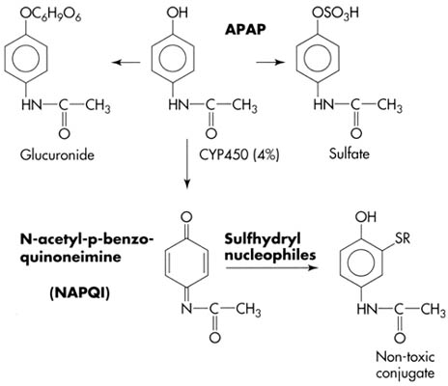
Paracetamol Metabolism

Slide 62
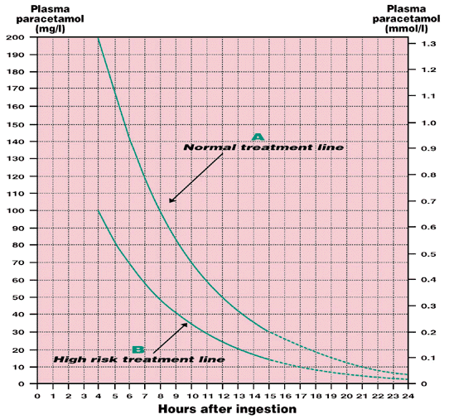
Treatment Graph

Slide 63
Paracetamol Overdose-management
Initial ABC ( usually well systemically)
Get a good history
  TIME TAKEN, AMOUNT –10g in adults
  Any other medication
  History of Liver disease
N-Acetylcysteine. Shown to be advantageous if given in the first 10 hours
Methonine effective in first 6 hours

Slide 64
N - Acetylcysteine
Specific antidote used for Paracetamol
Provides the Sulphydryl groups needed to increase the availability of Glutathione
So that Body can turn the TOXIC metabolite into the non toxic form and prevent Liver Cell Damage and NECROSIS

Slide 65
Aspirin Overdose
Early features
  hyperventilation, sweating, tremor, tinnitus, nausea / vomiting, or hyperpyrexia
Metabolic features
  Hypo- or hyper-glycaemia, hypokalaemia, respiratory alkalosis, metabolic acidosis
Others
  renal failure, pulmonary oedema, seizures, coma, death

Slide 66
Aspirin
Activated Charcoal
  1 hour
Gastric Lavage
  less than 1 hour .

Slide 67
Aspirin-Increasing Drug Elimination
Urinary Alkalinisation
  If you increase urinary pH from 5 to 8 there is a 10-20 fold increase in the renal salicylate clearance
  This is done by giving an infusion of Sodium Bicarbonate.

Slide 68
Aspirin- Increasing Drug Elimination
HAEMODIALYSIS
  Used in severe life threatening overdose

Slide 69
Management
General measures
Activated charcoal
Rehydrate, monitor glucose, correct acidosis and K+
If levels >500mg/L alkalanize urine (HCO₃⁻)
Levels > 700 mg/L before rehydration, renal failure or pulmonary oedema consider haemodialysis

Slide 70
TCAs -Introduction
Potentially fatal (2.5 to 3.5g of amitriptyline)
Neurological and cardiac problems common
Serious toxicity results from:-
  Ventricular dysrhythmias
  Seizures
  Hypotension
  Respiratory depression

Slide 71
TCAs-Features of poisoning
Peripheral
  Sinus tachycardia, hot dry skin, dry mouth, urinary retention, hypotension and hypothermia may occur
CNS
  Dilated pupils, ataxia, nystagmus, squint, ↓LOC, coma, seizures, respiratory depression, ↑tone, ↑ ↓reflexes, ↑ plantars
ECG
  prolonged PR and QRS interval, ↑ QT
  ventricular dysrhythmias

Slide 72
TCAs -Management
GCS and QRS, best indicators of toxicity
Supportive
Check airway, maintain ventilation, correct hypoxia
Correct hypotension (crystalloids)
Gastric lavage if within 1 hr, and activated charcoal
Rx fits and agitation with diazepam
Rewarm slowly if hypothermic

Slide 73
TCAs- Dysrhythmias
Careful ECG monitoring is required
  QRS interval is a guide to cardiac toxicity (>100ms)
Correct hypoxia and acidosis. Aim for a pH of 7.45-7.50 (no higher)
  use iv boluses of sodium bicarbonate

Slide 74
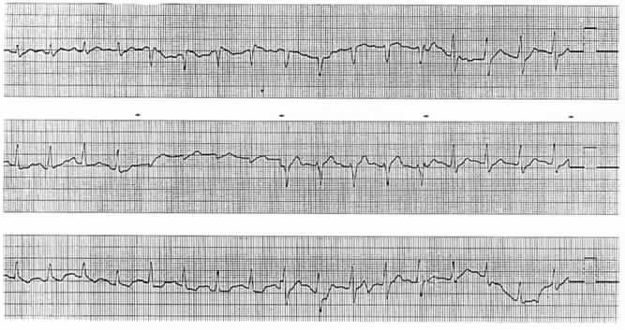
Tricyclic OD – Initial ECG

Slide 75
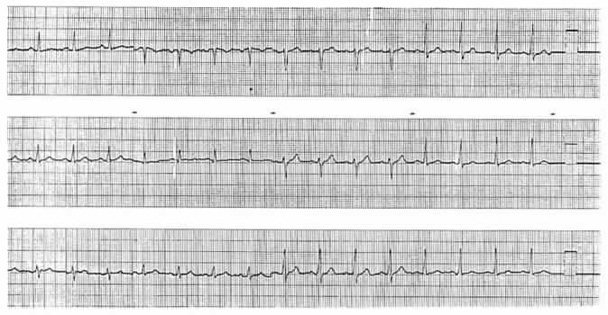
Tricyclic OD – Recovery ECG

Slide 76
Other agents
Opiates Naloxone
Iron Desferrioxamine
Lead Sodium EDTA
Digoxin FAB
Calcium blockers Calcium
Ethylene glycol Ethanol
Lithium Dialysis

Slide 77
The Case….
Picture yourself in Polonnaruwa hospital Intern
Ward 6 , teaming with patients….
Nurse tells you there is a sick patient
  36yo F
  Taken 100mls of Dimethoate after a domestic argument
There’s nowhere to run, or hide…. So you see the patient – what do you do?

